Slide 1
WES 237B: Master of Advanced Study in Wireless Embedded Systems
Pat Pannuto
Department of Computer Science and Engineering
University of California, San Diego
Summer Session 2022

Slide 2
WELCOME to WES 237B!

Slide 3
Designing and Optimizing Embedded Systems (Signal/Image/Video Processing) Applications on SoC

Slide 4
Designing and Optimizing Embedded Systems (Signal/Image/Video Processing) Applications on SoC

Slide 5
What is an embedded system?

Slide 6
What is an embedded system?
Specialized
Low power
Real-time
Properties of embedded systems

Slide 7
What is an embedded system?
Specialized
Low power
Real-time
High-performance
Properties of embedded systems

Slide 8
What is an embedded system?
A domain-specific + high-performance system

Slide 9
What is an embedded system?
A domain-specific + high-performance system
Achieving high-performance while reducing power consumption is a key, and how to do that?
There is no single answer! Usually, involves multiple factors (tradeoff) latency, throughput, power, cost,...

Slide 10
What is an embedded system?
A domain-specific + high-performance system
Achieving high-performance while reducing power consumption is a key, and how to do that?
There is no single answer! Usually, involves multiple factors (tradeoff) latency, throughput, power, cost,... What is ”performance” anyway??

Slide 11
How to design an embedded system for this app?
void matrix_vector_multiply(int in1[SIZE][SIZE], int in2[SIZE], int out[SIZE]) {
for(int i = 0; i < SIZE; i++){
for(int j = 0; j < SIZE; j++){
acc = acc + in1[i][j] * in2[j];
}
out[i] = acc;
}
}
void prefix_sum(int in[SIZE], int out[SIZE]) {
for(int i = 1; i < SIZE; ++i){
out[i] = out[i-1] + in[i];
}
}
int main() {
matrix_vector_multiply(A, B, C);
prefix_sum(C, D);
return 0;
}
0
2
1
6
3
1
2
5
0
2
3
9
12
13
15
20
Notes:
Work through what each function actually computes
- show trivial to //ize MVMultiply (vectorize/unroll inner loop)
- why harder to //ize prefix sum (w/ naïve impl. at least)

Slide 12
Embedded systems design → Trade-offs
Performance, power, cost, programming choice,…etc.
CPU
Matrix Vector Multiplication
Prefix sum

Slide 13
Embedded systems design → Trade-offs
Performance, power, cost, programming choice,…etc.
FPGA + CPU
Matrix Vector Multiplication
Parallel
Prefix sum
Sequential

Slide 14
Embedded systems design → Trade-offs
Performance, power, cost, programming choice,…etc.
FPGA + CPU
Matrix Vector Multiplication
Parallel
What if memory is bottleneck?
Prefix sum
Sequential

Slide 15
Embedded systems design → Trade-offs
Performance, power, cost, programming choice,…etc.
GPU ?
Matrix Vector Multiplication
Parallel
Prefix sum
Sequential

Slide 16
Embedded systems design → Trade-offs
Performance, power, cost, programming choice,…etc.
Can you re-write the Prefix sum (seq code) to tailor parallel architecture?
GPU ?
Matrix Vector Multiplication
Parallel
Prefix sum
Sequential

Slide 17
Designing and Optimizing Embedded Systems (Signal/Image/Video Processing) Applications on SoC

Slide 18
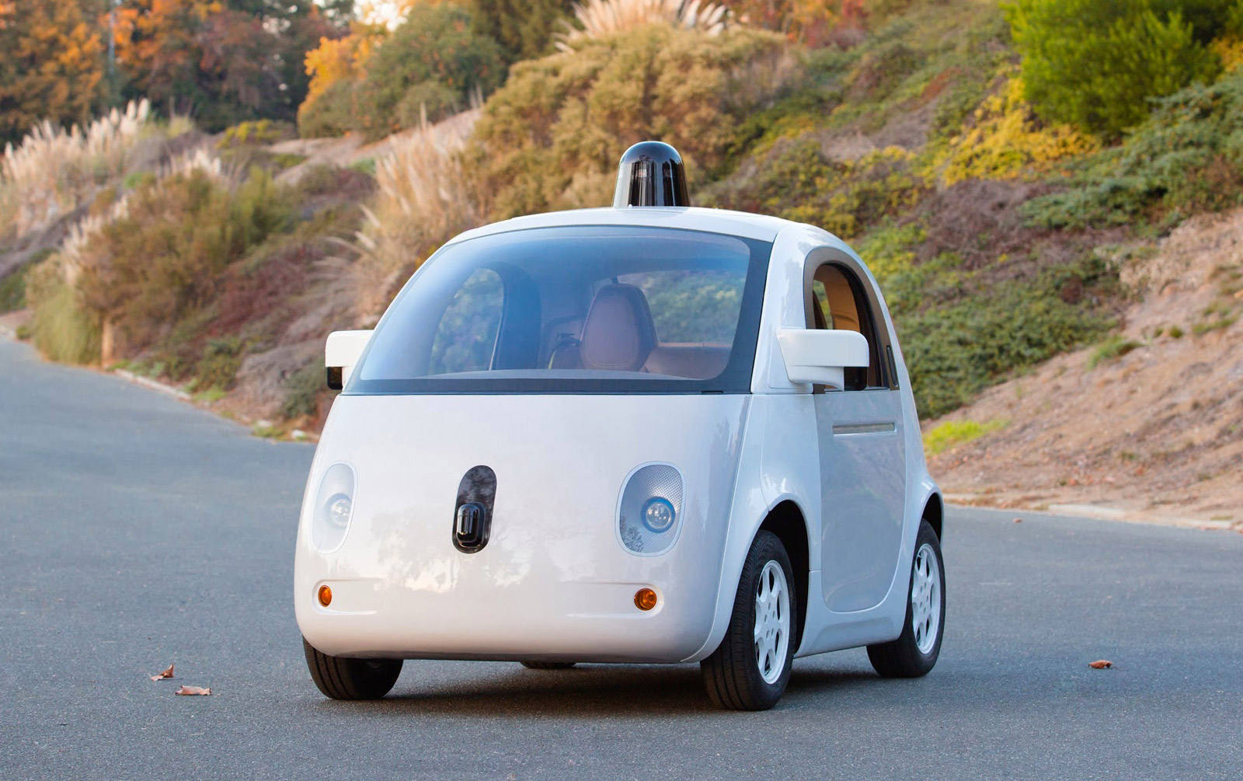
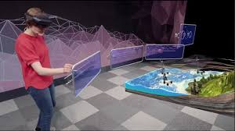
Why study signal/image/video processing?
Emerging applications ADAS/AR/VR uses vision/image processing
Requires high performance and low power

Slide 19
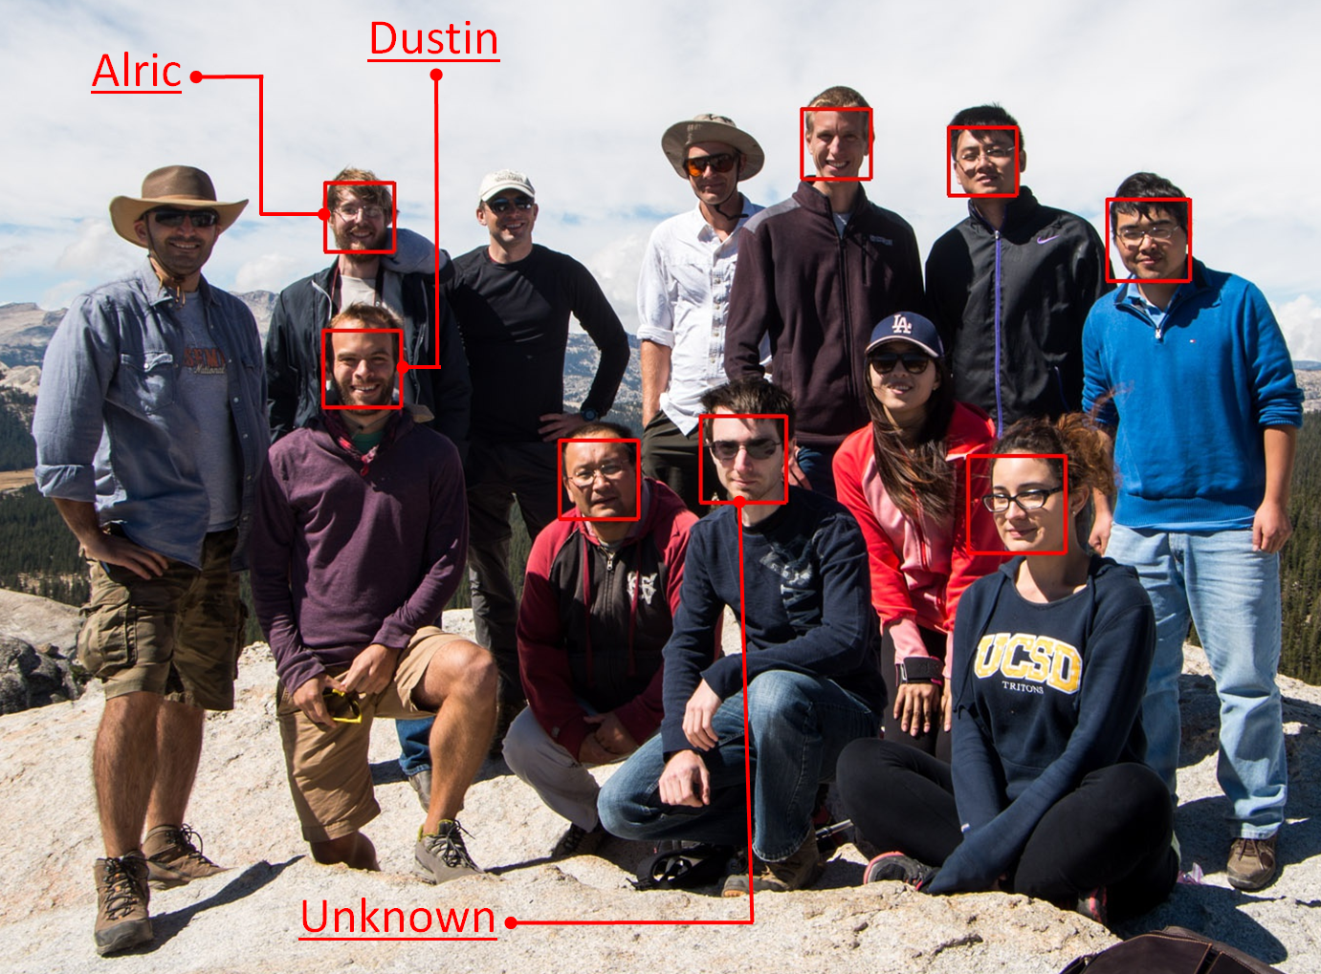
Why study signal/image/video processing?
Emerging applications ADAS/AR/VR uses vision/image processing
Requires high performance and low power

Slide 20
Designing and Optimizing Embedded Systems (Signal/Image/Video Processing) Applications on SoC

Slide 21
What is a System-on-chip (SoC)?

Slide 22
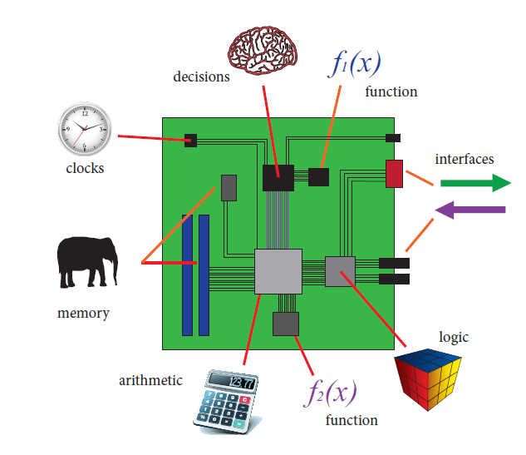
System on a Chip (SoC)
The Zynq Book http://www.zynqbook.com/

Slide 23
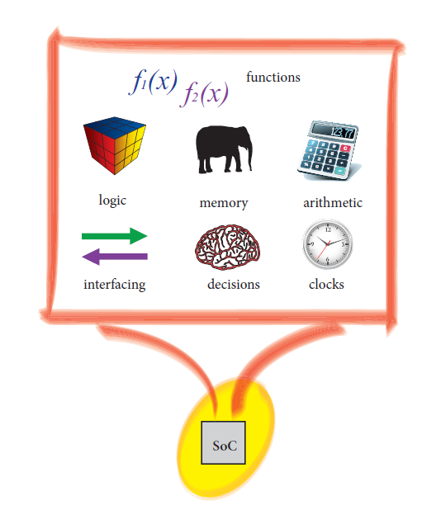
System on a Chip (SoC)
The Zynq Book http://www.zynqbook.com/, http://www.pynq.io/

Slide 24
SoC
UART
DSP
ADC/DAC
Memory Controller
DMA
USB
CPU
Softcore
Notes:
Large number of modules
Special function
Your system is s
How are you going to connect these modules ?
What happens if I add new IP
We need a standard.

Slide 25
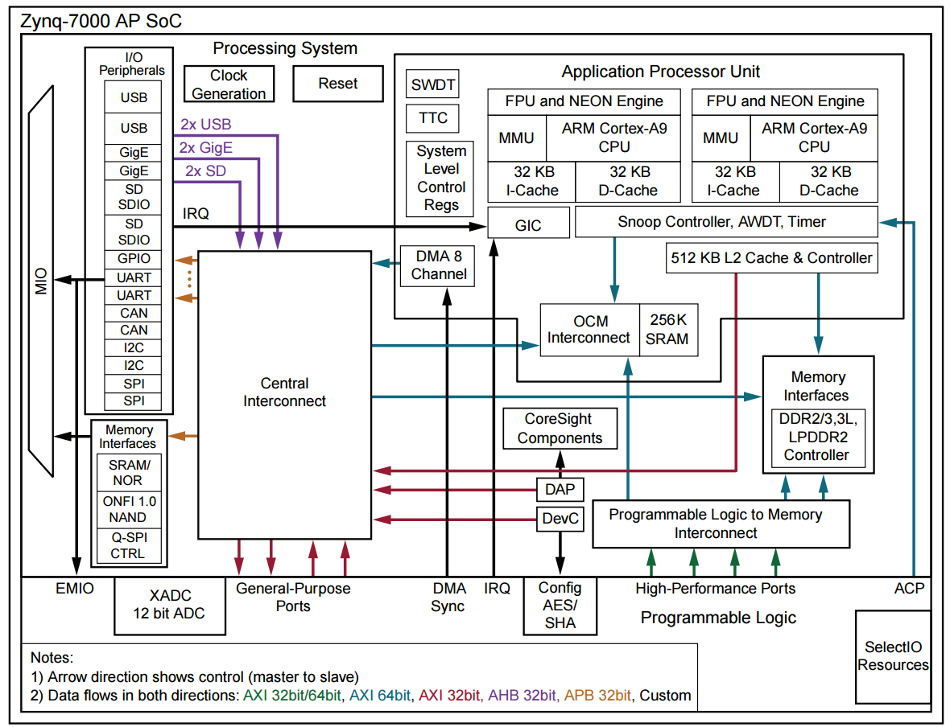
SoC
UART
DSP
ADC/DAC
Memory Controller
DMA
USB
CPU
Softcore
Notes:
Ask folks to find the CPU in the block diagram ☺

Slide 26
SoC
UART
DSP
ADC/DAC
Memory Controller
DMA
USB
CPU
Softcore

Slide 27
SoC
UART
DSP
Vendors buy ARM IP Cores and develop SoCs
Xilinx Zynq/Pynq
Jetson Nvidia
A protocol
Must be standard
Maintenance
Modularity (Re-use)
ADC/DAC
Memory Controller
DMA
USB
CPU
Softcore

Slide 28
SoC
Different protocols…
Core-Connect (IBM)
Wishbone (OpenCores/OSH)
AXI ← ARM’s
Xilinx bought in most here
Avalon (Altera, now Intel)
MIPI… [~mobile phones]
SLIMBus, LLI, UniPro, I3C, …
UART
DSP
ADC/DAC
Memory Controller
DMA
USB
CPU
Softcore

Slide 29
SoC
Peripherals
CPU
Co-processor

Slide 30
SoC
Peripherals
CPU/GPU
Co-processor (Accelerator Design)
WES 237B
WES 237C

Slide 31
ARM
Introduced in 1980s into customer electronics
De facto embedded processor technology
Not usually manufactured as a standalone chip
Usually part of a System-on-chip that is customized for specific application
ARM is everywhere including your phone, TV, ipad,… as a form of SoC.
SoC is a collection of interconnected hardware modules
A typical SoC include one or more ARM processor cores
First major customer was Apple (Netwon PDA)

Slide 32
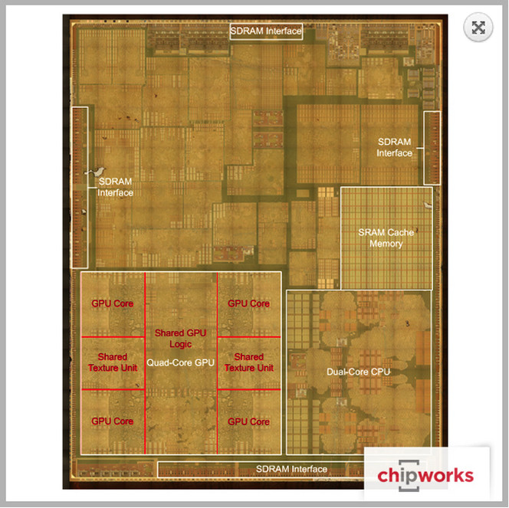
Apple A8 (iPhone 6) … Apple A15 (iPhone 13)

Slide 33
ARM Technology
ARM (Advanced RISC Machine) controlled by ARM
ARM writes specification of ARM processors
Specifications
Instruction set architecture
MMU
Interrupt and Exception handling
Caches
Virtualization
CPUs based on ARM1, ARM2, ARM3 instruction set architecture (ISA) were introduced around 1980s.
Due to computations from Intel x86 and Motorola 68,000 CPU, ARM switched its business model
Selling the rights to use its processor design or ISA (specification)
ARMv4, ARMv5, ARMv6, ARMv7, ARMv8

Slide 34
ARM Technology
ARM holding creates IP cores based on specifications
IP core = VHDL or Verilog implementation of a specification
Examples:
ARM976 = Implementation of ARMv5
ARM1176 = Implementation of ARMv6
Cortex – A15 = Implementation of ARMv7-A
Cortex- A53 = Implementation of ARMv8-A
Multiple implementation of the same specification is possible
Cortex-A5,6,7,…15
Cortex-A5 is low power, Cortex-A15 is high-performance
Difference of pipeline, out of order execution, size of cache, ,…

Slide 35
ARM Processor Families
Three ‘profiles’ of cores:
Cortex-A Application
Cortex-R Real Time
Cortex-M Mobile
… get it?

Slide 36
ARM Technology
ARM processors are sold as a reusable IP cores
Consistent instruction set allows
Common tool chain such as compilers debuggers, and code libraries
Most ARM processors are used with Co-processors (FPGA, GPU,..)

Slide 37
ARM Technology
Specification
e.g., ARMv7
ARM IP core
Cortex-A9
SoC
e.g., Zynq
Hardware Platform
e.g., Pynq, Zedboard

Slide 38
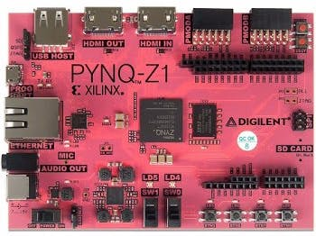
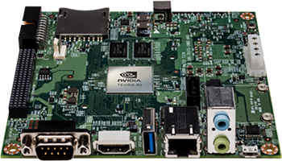
WES237B Hardware
Open source project to use Xilinx platforms
Xilinx Zynq Chip
PL & PS part
Allows to use python/libraries to program PS/PL
Tegra K1 SOC
NVIDIA Kepler GPU with 192 CUDA Cores
NVIDIA 4-Plus-1™ Quad-Core ARM® Cortex™-A15 CPU
2 GB x16 Memory with 64-bit Width
http://www.nvidia.com/object/jetson-tk1-embedded-dev-kit.html

Slide 39
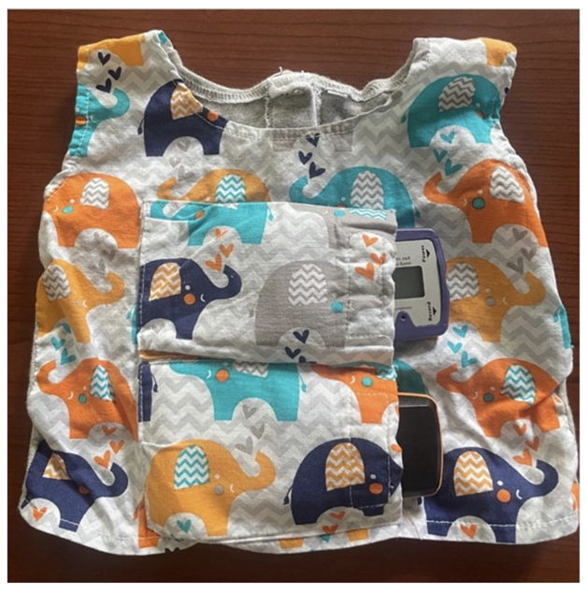
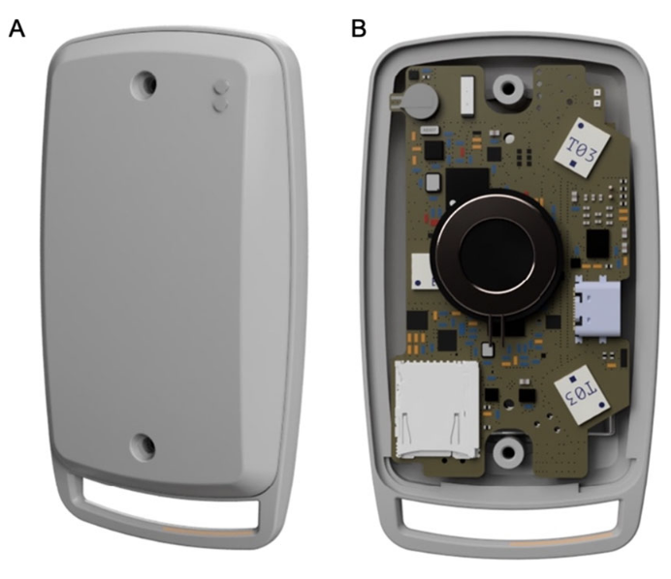
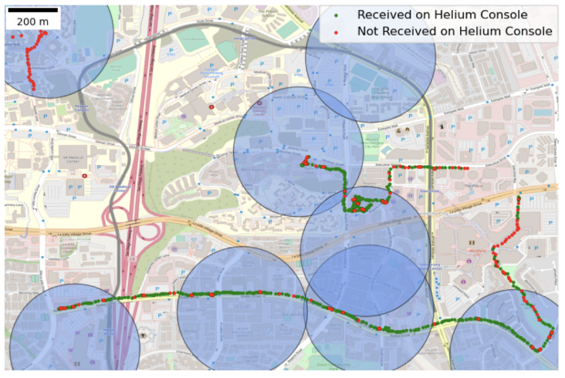
WES 237B
Course web:
https://patpannuto.com/classes/2022/summer/wes237b
Instructor
10-year anniversary of embedded systems work
Primary research thrusts on ‘more embedded’ applications
Amazing TA
Teaching experience across many courses and significant experience with embedded platforms
Technically very strong – your hands-on expert!

Slide 40
What to expect from WES 237B?
Goal 1: Optimization/Performance measurement of emerging applications on a SoC
Software optimization for SoC (pipelining, unrolling, multi-threading), blocking, memory optimizations
Goal 2: Understanding Parallel Programming Paradigms and Parallel Patterns
Understanding parallel programming using emerging applications (covers some case studies using computer vision/image processing applications)

Slide 41
Grading and Grading Policy
Grading
Student group research and participation: 30%
Class participation 10%
Group research and presentation 20%
Assignments : 70%
Assignment 1: 10%
Assignment 2 to 5 : 15%
Assignments are for groups of 2
Group presentations are for different group of 2 — network! ☺
No show up/being late: -5% from your grade (need to get explicitly permission) each occasion (preferably in advance, but life happens)

Slide 42
Group Research Presentation (~50 minutes)
Content: How well your presentation covers the given topic (specific materials/papers will be given)?➔5%
Presentation: How you are presenting the material to audience of a wide background in an allocated time? ➔5%
Discussion and Future Directions /Questions: Leading the discussion (discussing pros/cons) of the technology including benefits, current technological challenges/limitations and opportunities, how this work is different than previous ones (what are the main contributions)?➔10%
Instructors/TAs/students will ask questions & participate in the discussion
Logistics
Send me the outline of your presentation at least a week before the class
Discuss/send me the (close to final) presentation 2 days before the class.

Slide 43
Student Group Presentation Topics (Tentative)
Emerging Memory Technologies & in-memory computing
https://emai19.sites.stanford.edu/workshop-presentations
Phase Change Memory
Emerging Processing Technologies
Optical computing https://lighton.ai/, https://lightmatter.co/, https://www.optalysys.com/
Efficient Deep Learning Hardware/Software Architectures
Sze, Vivienne, et al. "Hardware for machine learning: Challenges and opportunities." 2017 IEEE Custom Integrated Circuits Conference (CICC). IEEE, 2017. https://arxiv.org/pdf/1612.07625.pdf
https://cs217.stanford.edu/
Han, Song, et al. "EIE: efficient inference engine on compressed deep neural network." ACM SIGARCH Computer Architecture News 44.3 (2016): 243-254. https://arxiv.org/pdf/1602.01528.pdf
Gamboa, Noah, et al. "Campfire: Compressible, Regularization-Free, Structured Sparse Training for Hardware Accelerators." arXiv preprint arXiv:2001.03253 (2020) https://arxiv.org/pdf/2001.03253.pdf
Yao, Shuocaho, et al. “DeepIoT: Compressing Deep Neural Network Structures for Sensing Systems with a Compressor-Critic Framework.” https://dl.acm.org/doi/abs/10.1145/3131672.3131675
Emerging Parallel Programming Systems of Parallel Architectures
Lai, Yi-Hsiang, et al. "HeteroCL: A multi-paradigm programming infrastructure for software-defined reconfigurable computing." Proceedings of the 2019 ACM/SIGDA International Symposium on Field-Programmable Gate Arrays. 2019.
Li, Tzu-Mao, et al. "Differentiable programming for image processing and deep learning in Halide." ACM Transactions on Graphics (TOG) 37.4 (2018): 1-13.
Emerging Sensor Technologies and Enabling Applications
Dynamic Vision Sensor
http://rpg.ifi.uzh.ch/CVPR19_event_vision_workshop.html
Processing inside the sensor
Sony IMX 500 https://www.cinema5d.com/sony-imx500-worlds-ai-image-sensor-announced/

Slide 44
WES 237B does not teach you C!
We do not teach you basics of C!
Although, we cover advanced concepts and optimizations
We will try to help you
You are expected to catch up if you do not have C programming background
Assignment 1 (part two) is about C programming

Slide 45
Questions ?

Slide 46
Embedded Compute and Text Compression

Slide 47
Processors
ISA
A definition of instructions that a processor can execute
x86 is an ISA, many realization of x86
ARMv1, ARMv2,…ARMv7 are ISAs.
Realization or Chip (“Soft” or “Hard” cores)
Software
ISA
Hardware
Notes:
What are the advantages of sharing an ISA ?

Slide 48
An Instruction Set Architecture is an abstraction of a computational machine
An ISA is “the agreed-upon interface between all the software that runs on the machine and the hardware that executes it.”
Application
Operating
Compiler
System
Instruction Set
Architecture
Instr. Set Proc.
I/O system
Digital Design
Circuit Design
Notes:
the ISA is the HW/SW interface (book)
it is a useful abstraction in both directions.

Slide 49
Computers do not speak English And they do not speak C or Java or Python or Haskell (or…) either
Specification
“Swap two array elements.”
Programmer
High Level Language
(C, Java, Rust, etc)
int temp = array[index];
array[index] = array[index + 1];
array[index + 1] = temp;
Compiler
lw $15, 0($2)
lw $16, 4($2)
sw $16, 0($2)
sw $15, 4($2)
Assembly Language
Assembler
1000110001100010000000000000000
1000110011110010000000000000100
1010110011110010000000000000000
1010110001100010000000000000100
Machine Language
Machine Interpretation
Control Signal Spec
ALUOP[0:3] <= InstReg[9:11] & MASK
Notes:
imp points.
-the computer doesn’t understand for i=0ton
-one-to-many HLL to AL
-one-to-one AL to ML
-ISA (grey box) is fixed
a computer is a device you can give commands to. But only a very limited set of commands. That set is the IS. It is the language the computer understands.
But at a low level, it doesn’t even really understand that...
Abstraction.
Computer understands only ones and zeroes. But it also understands groups of ones and zeroes, so it understands larger numbers. That is useful abstraction for the computer.

Slide 50
The Instruction Set Architecture
that part of the architecture that is visible to the programmer
available instructions (“opcodes”)
number and types of registers
instruction formats
storage access, addressing modes
exceptional conditions
Notes:
Note: visible to programmer includes by extension all the tools used by the programmer (i.e. toolchains)

Slide 51
Embedded Compute Units
Processor | Description | Applications
Microcontroller | Microcontrollers is a small computer (CPU, memory I/O) | Suitable for application that require small memory and less computation
DSP | Processors specifically designed for signal processing Repetitive numeric computations High memory bandwidth (arrays) Real-time processing DSP objectives Power Development time Throughput (Processing) | Audio Coding/Decoding Video/Image/ Computer Vision Convolution Communications FIR, FFT
GPU | Graphics processors (GPGPU) | General (embedded → data center)
FPGA | Programmable Custom Hardware | General (embedded → data center)

Slide 52
Design tradeoffs…
CPU
DSP
GPU
FPGA
ASIC
Efficiency, performance (given workload..)
Generality, flexibility

Slide 53
A field-programmable gate array (FPGA)

Slide 54
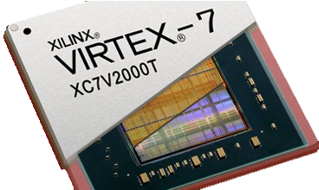
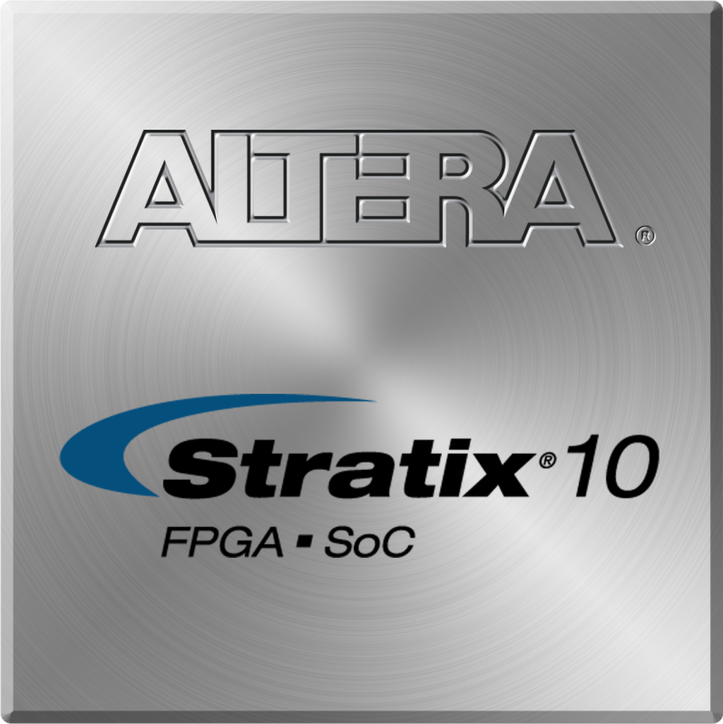
What is an FPGA?
A field-programmable gate array (FPGA)

Slide 55
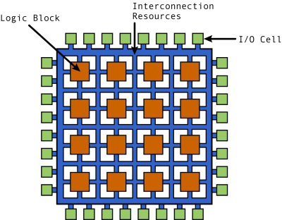
What is an FPGA?
A field-programmable gate array (FPGA)

Slide 56
FPGA
Flexibility to implement any logic
F(x,y,z) = xy + z’
F(x,y,z) = xyz

Slide 57
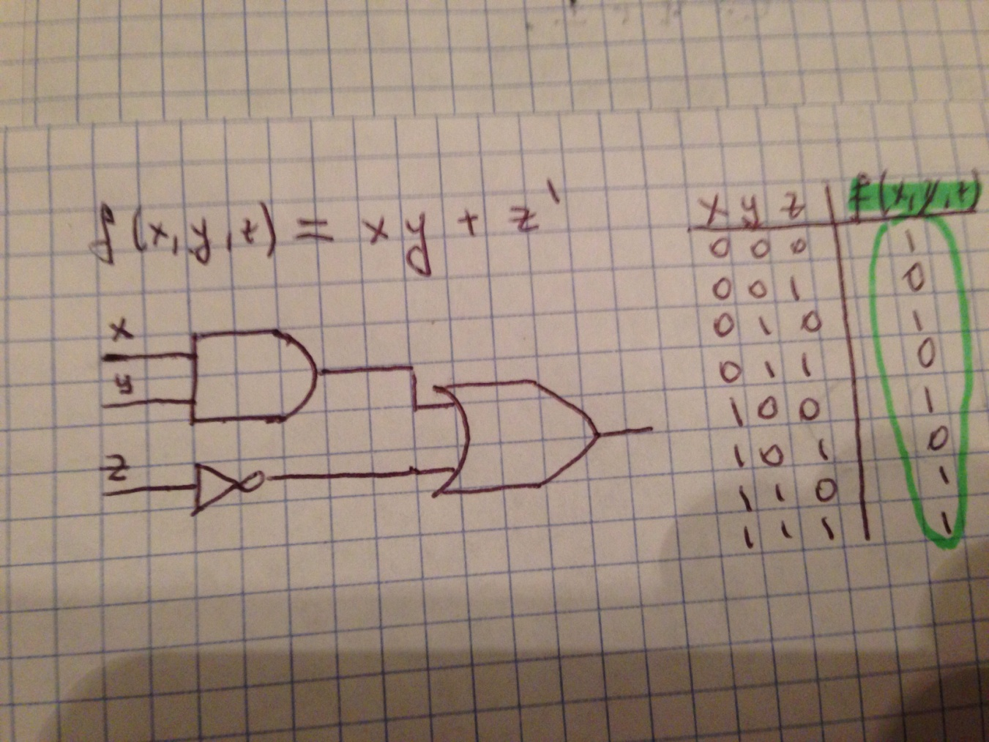
FPGA
Flexibility to implement any logic
F(x,y,z) = xy + z’
F(x,y,z) = xyz

Slide 58
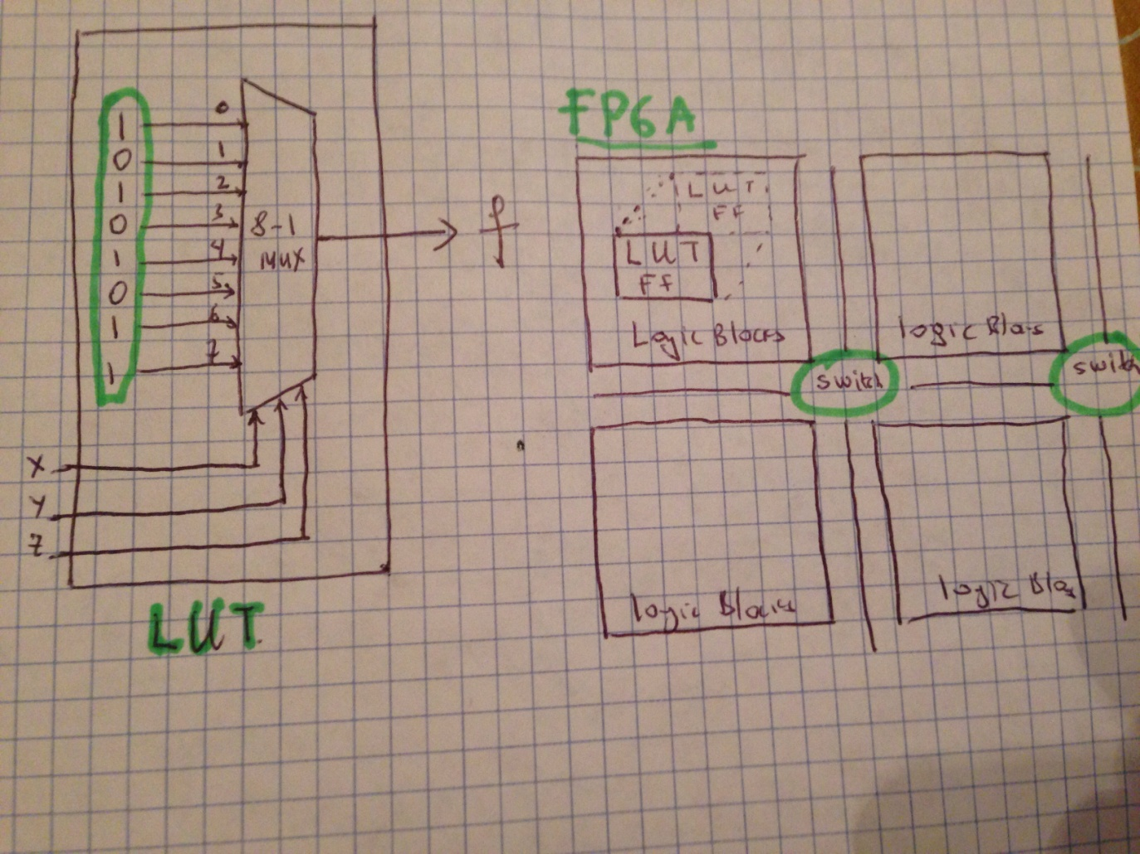
FPGA
Flexibility to implement any logic
F(x,y,z) = xy + z’
F(x,y,z) = xyz

Slide 59
Why FPGAs?
A field-programmable gate array (FPGA)
Vision (image) → High performance and low (er) power

Slide 60
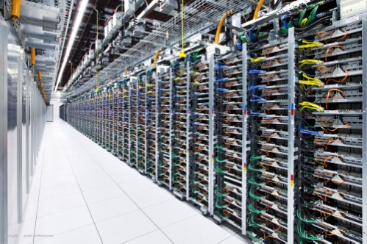
Motivation: Applications of FPGA
Data centers^{[1]}
[1] Andrew Putnam et al. “ A Reconfigurable Fabric for Accelerating Large-Scale Datacenter Services,”, ISCA, 2014
Notes:
FPGAs are emerging as an alternative platofrm for a number of computationally depending applications due to its performance per watt benefits.

Slide 61
Motivation: Applications of FPGA
Data centers^{[1]}
Database^{[2]}
[1] Andrew Putnam et al. “ A Reconfigurable Fabric for Accelerating Large-Scale Datacenter Services,”, ISCA, 2014
[2] Casper et al. "Hardware acceleration of database operations", FPGA''14
Notes:
FPGAs are emerging as an alternative platofrm for a number of computationally depending applications due to its performance per watt benefits.

Slide 62
Motivation: Applications of FPGA
Data centers^{[1]}
Database^{[2]}
CNN ^{[3]}
Big Data^{[4]}
[1] Andrew Putnam et al. “ A Reconfigurable Fabric for Accelerating Large-Scale Datacenter Services,”, ISCA, 2014
[2] Casper et al. "Hardware acceleration of database operations", FPGA''14
[3] Zhang et al. "Optimizing fpga-based accelerator design for deep convolutional neural networks.", FPGA 2015
[4] Rouhani et al. "SSketch: An Automated Framework for Streaming Sketch-based Analysis of Big Data on FPGA.", FCCM 2015
Notes:
FPGAs are emerging as an alternative platofrm for a number of computationally depending applications due to its performance per watt benefits.

Slide 63
Motivation: Applications of FPGA
Data centers^{[1]}
Database^{[2]}
CNN ^{[3]}
Big Data^{[4]}
[1] Andrew Putnam et al. “ A Reconfigurable Fabric for Accelerating Large-Scale Datacenter Services,”, ISCA, 2014
[2] Casper et al. "Hardware acceleration of database operations", FPGA''14
[3] Zhang et al. "Optimizing fpga-based accelerator design for deep convolutional neural networks.", FPGA 2015
[4] Rouhani et al. "SSketch: An Automated Framework for Streaming Sketch-based Analysis of Big Data on FPGA.", FCCM 2015
Notes:
FPGAs are emerging as an alternative platofrm for a number of computationally depending applications due to its performance per watt benefits.

Slide 64
Applications

Slide 65
Designing an FPGA?
You will learn in WES 237C!

Slide 66
Designing an FPGA ?
VHDL,

Slide 67
Designing an FPGA?
VHDL,
Verilog,
SystemVerilog,
….

Slide 68
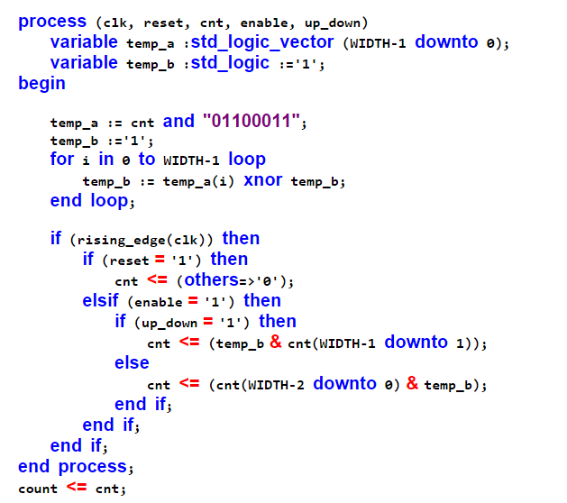
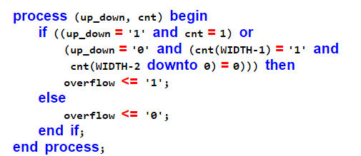
VHDL???

Slide 69
High-Level Synthesis: A way to program FPGA from C
C/C++
Magic
VHDL (Verilog)

Slide 70
High-Level Synthesis
C/C++
Directives

Slide 71
High-Level Synthesis
C/C++
Directives
Directives: Pipeline, partition, dataflow, inline,reshape, resource, stream, top, interface, expression balance, reset, allocation, dependence, function_initiate,…
HLS

Slide 72
High-Level Synthesis
C/C++
Directives
Directives: Pipeline, partition, dataflow, inline,reshape, resource, stream, top, interface, expression balance, reset, allocation, dependence, function_initiate,…
HLS
VHDL (Verilog)

Slide 73
High-Level Synthesis
void HelloWorld(
int A[8],
int B[8]) {
#pragma unroll
for(int i=0;i<8;i++){
B[i]=A[i]*3;
}
}
C/C++
Directives
HLS
VHDL (Verilog)

Slide 74
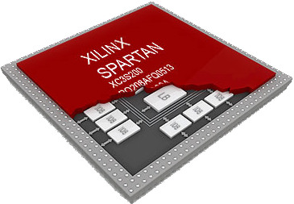
High-Level Synthesis
void HelloWorld(
int A[8],
int B[8]) {
#pragma unroll
for(int i=0;i<8;i++){
B[i]=A[i]*3;
}
}
C/C++
Directives
HLS
VHDL (Verilog)

Slide 75
High-Level Synthesis
void HelloWorld(
int A[8],
int B[8]) {
#pragma unroll
for(int i=0;i<8;i++){
B[i]=A[i]*3;
}
}
C/C++
Directives
Vivado HLS
IP
Bitstream
VHDL (Verilog)
Vivado

Slide 76
Summary of Embedded Systems and Trends
Embedded systems → Getting complex
High performance computing & embedded systems → Merging
GPUs and FPGAs are two key players
GPUs→ easy to program, high power consumption
Good for bulk processing
FPGAs→ hard(er) to program, low power consumption
Good for streaming applications
Flexibility
ASIC→ Expensive and not flexible
Power/performance
FPGA→ Moving towards SoC
Programming from high-level languages such as C

Slide 77
System on a Chip (SoC): Zynq
Processing System (PS)
Application processor unit (APU)
Memory interfaces
I/O peripherals (IOP)
Interconnect
Programmable Logic (PL)

Slide 78
System on a Chip (SoC)
Lower cost
Faster and more secure data transfer between components
Smaller physical size
Lower power consumption
Has higher overall speed

Slide 79
System on a Chip (SoC): Zynq

Slide 80
PL Special Resources: BRAM & DSP48E1
Block Rams (BRAMs)
RAM, ROM, FIFO
Each block ram can store up to 36 Kb info
Can be configured as 36Kb or 18Kb
DSP48E1
Pre-adder/subtractor, multiplier, post-adder/subtractor
IOBs
Pre-adder/subtractor, multiplier, post-adder/subtractor
XADC
A dedicated set of ADC blocks
Clocks
4 clocks from PS and other PL clocks

Slide 81
PS an PL interface
Advanced eXtensible Interface (AXI)
Version AXI4
ARM AMBA® 3.0 open standard
First release 1996 for microcontrollers
De-facto standard for on-chip communication

Slide 82
SoC Design Flow
Application
Defining Requirements
Defining Specification
Software/ Hardware Partition
Hardware Development & Testing
Software Development & Testing
System Integration & Testing

Slide 83
Compression: Huffman Encoding

Slide 84
Compression
Encoder
Decoder

Slide 85
Huffman Encoding
Greedy Algorithm
Input: text data (symbols)
Find histogram of symbols
L = Sort according to frequencies (histogram) of symbols
Create a Huffman tree
Select two symbols with minimum frequencies
Create a node and add their symbols
Add the new node to L in a sorted order
Assign a 0 to left edge and 1 to right edge
Create a codeword from root of Huffman tree to the leaves of Huffman tree
Return codeword

Slide 86
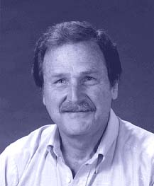
Data Compression: Huffman Encoding
David Albert Huffman
Invented during his PhD at MIT
“A Method for the Construction of Minimum-Redundancy Codes”, 1952
Data: AAABB
Fixed Length Encoding:
A = 001
B= 010
→ 001001001010010 → 15 bits
Huffman Encoding:
Variable Length Encoding
A = 1
B= 010
→ 111010010 →9 bits

Slide 87
Histogram
Input:
AABACDCDDDDEEEEEF

Slide 88
Histogram
S | F
A | 3
B | 1
C | 2
D | 5
E | 5
F | 1
Input:
AABACDCDDDDEEEEEF

Slide 89
Sorting by frequencies
Radix sort, merge sort, quick sort,…etc.
We will learn how to design parallel sorting algorithms

Slide 90
Radix Sort
1 | 2 | 3
 |  | 2
9 | 9 | 9
6 | 0 | 9
1 | 1 | 1
1 | 2 | 3
0 | 0 | 2
9 | 9 | 9
6 | 0 | 9
1 | 1 | 1
1 | 1 | 1
0 | 0 | 2
1 | 2 | 3
9 | 9 | 9
6 | 0 | 9

Slide 91
Radix Sort
1 | 2 | 3
 |  | 2
9 | 9 | 9
6 | 0 | 9
1 | 1 | 1
1 | 2 | 3
0 | 0 | 2
9 | 9 | 9
6 | 0 | 9
1 | 1 | 1
1 | 1 | 1
0 | 0 | 2
1 | 2 | 3
9 | 9 | 9
6 | 0 | 9
6 | 0 | 9
0 | 0 | 2
1 | 1 | 1
1 | 2 | 3
9 | 9 | 9

Slide 92
Radix Sort
1 | 2 | 3
 |  | 2
9 | 9 | 9
6 | 0 | 9
1 | 1 | 1
1 | 2 | 3
0 | 0 | 2
9 | 9 | 9
6 | 0 | 9
1 | 1 | 1
1 | 1 | 1
0 | 0 | 2
1 | 2 | 3
9 | 9 | 9
6 | 0 | 9
6 | 0 | 9
0 | 0 | 2
1 | 1 | 1
1 | 2 | 3
9 | 9 | 9
0 | 0 | 2
1 | 1 | 1
1 | 2 | 3
6 | 0 | 9
9 | 9 | 9

Slide 93
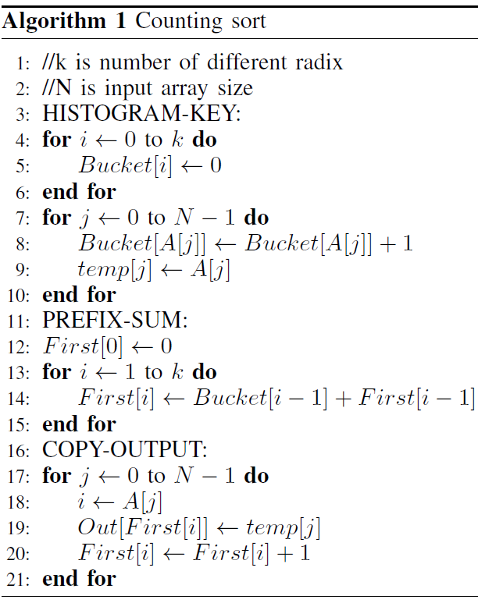
Radix Sort
1 | 2 | 3
 |  | 2
9 | 9 | 9
6 | 0 | 9
1 | 1 | 1
1 | 2 | 3
0 | 0 | 2
9 | 9 | 9
6 | 0 | 9
1 | 1 | 1
1 | 1 | 1
0 | 0 | 2
1 | 2 | 3
9 | 9 | 9
6 | 0 | 9
6 | 0 | 9
0 | 0 | 2
1 | 1 | 1
1 | 2 | 3
9 | 9 | 9
0 | 0 | 2
1 | 1 | 1
1 | 2 | 3
6 | 0 | 9
9 | 9 | 9
Stage 1
Stage 2
Stage 3
Counting Sort
Radix Sort
New Radix Sort
Option 1: HW → pipeline
Option 2: Parallel Hardware
Histogram
H
CS
P
CS
RS
RS
Prefixsum
H
CS
There are a number of ways of designing parallel algorithms.
Notes:
Different stages of Radix sort is pipelined so that throughput of the overall system increases. Each stage of Radix sort is implemented by counting sort as shown by this algorithm. We explain the counting sort in next slide

Slide 94
Counting Sort
[0, 3, 2, 2, 3, 2, 0, 3, 2, 1]
Input array
(C₀, C₁, C₂, C₃) = [2, 1, 4, 3]
Calculate occurrence of each number. C₀ is the count of 0
(O₀, O₁, O₂, O₃) = (0, 2, 3, 7)
We take the prefix sum of the counts transforms it to an offset table.
Re-order (copy out) step where values are
Copied into the right location using prefix table.
[0, 0, 1, 2, 2, 2, 2, 3, 3, 3]
Counting sort/Radix sort are (parallel) architecture friendly algorithms
➔ Suitable for parallel architectures such as GPU (including multi core parallelization)

Slide 95
Huffman Tree Creation
Sort
Create Tree
S | F
F | 1
B | 1
C | 2
A | 3
D | 5
E | 5
0
17
1
0
7
10
1
0
1
A
4
D
E
0
1
2
C
0
1
F
B

Slide 96
Huffman Tree Creation
S | F
F | 1
B | 1
C | 2
A | 3
D | 5
E | 5

Slide 97
Huffman Tree Creation
S | F
F | 1
B | 1
C | 2
A | 3
D | 5
E | 5
n1
2
F
1
B
1

Slide 98
Huffman Tree Creation
S | F
F | 1
B | 1
C | 2
A | 3
D | 5
E | 5
n1 | 2
n1
2
F
1
B
1

Slide 99
Huffman Tree Creation
S | F
F | 1
B | 1
C | 2
A | 3
D | 5
E | 5
n1 | 2
n1
2
F
1
B
1

Slide 100
Huffman Tree Creation
S | F
F | 1
B | 1
C | 2
A | 3
D | 5
E | 5
n1 | 2
n2
4
n1
2
C
2
F
1
B
1

Slide 101
Huffman Tree Creation
S | F
F | 1
B | 1
C | 2
A | 3
D | 5
E | 5
n1 | 2
n2 | 4
n2
4
n1
2
C
2
F
1
B
1

Slide 102
Huffman Tree Creation
S | F
F | 1
B | 1
C | 2
A | 3
D | 5
E | 5
n1 | 2
n2 | 4
A
3
n2
4
n1
2
C
2
F
1
B
1

Slide 103
Huffman Tree Creation
S | F
F | 1
B | 1
C | 2
A | 3
D | 5
E | 5
n1 | 2
n2 | 4
n3 | 7
n3
7
A
3
n2
4
n1
2
C
2
F
1
B
1

Slide 104
Huffman Tree Creation
n5
17
S | F
F | 1
B | 1
C | 2
A | 3
D | 5
E | 5
n1 | 2
n2 | 4
n3 | 7
n4 | 10
n5 | 17
n3
7
n4
10
A
3
n2
4
D
5
E
5
n1
2
C
2
F
1
B
1

Slide 105
Huffman Tree Creation
Sort
Create Tree
n5
17
S | F
F | 1
B | 1
C | 2
A | 3
D | 5
E | 5
n3
7
n4
10
A
3
n2
4
D
5
E
5
n1
2
C
2
F
1
B
1

Slide 106
Huffman Tree Creation
Sort
Create Tree
n5
17
S | F
F | 1
B | 1
C | 2
A | 3
D | 5
E | 5
0
1
n3
7
n4
10
0
0
1
A
3
n2
4
D
5
E
5
0
1
n1
2
C
2
0
1
F
1
B
1

Slide 107
Huffman Tree Creation
Sort
Create Tree
n5
17
S | F
F | 1
B | 1
C | 2
A | 3
D | 5
E | 5
0
1
Symbol | Code
A | 00
F | 0100
B | 0101
C | 011
D | 10
E | 11
n3
7
n4
10
0
1
0
1
A
3
n2
4
D
5
E
5
0
1
n1
2
C
2
0
1
Huffman Tree Creation is Sequential Process
➔ Suitable for CPU architecture.
F
1
B
1

Slide 108
Parallel Bit Length Calculation
Sort
Create Tree
Compute Bit Len
n5
17
S | F
F | 1
B | 1
C | 2
A | 3
D | 5
E | 5
Parent Address
1 | 2 | 4 | 4 | 0
n3
7
n4
10
Left
F | n1 | A | D | n3
Right
B | C | n2 | E | n4
Address
A
3
n2
4
D
5
E
5
0 | 1 | 2 | 3 | 4
This storage (Parent Address, Left, Right) allows parallel bit length calculation
Partitioning the Huffman Tree in horizontal direction at any point will result independent data in Parent Address, Left and Right
2
2
2
n1
2
C
2
3
F
1
B
1
4
4

Slide 109
Text compression with Huffman Encoding
Huffman Encoding
Canonical Huffman coding
Encoder
Decoder
Encoder
Decoder
Bit
Length

Slide 110
Canonical Huffman Encoding
Memory efficient
Faster decoding
Encoder
Decoder
Bit
Length
https://en.wikipedia.org/wiki/Canonical_Huffman_code

Slide 111
Software Optimization

Slide 112
Optimizations

Slide 113
Optimize ➔ Performance

Slide 114
Measuring Performance
Notes:
What are the goals of Software Optimization ?

Slide 115
The bottom line: Performance
Time to do the task
execution time, response time, latency
Tasks per day, hour, week, sec, ns. ..
throughput, bandwidth
Time to Bay Area
Speed
Passengers
Throughput (pmph)
Ferrari
3.1 hours
160 mph
2
320
Bus
7.7 hours
65 mph
60
3900

Slide 116
Measures of “Performance”
Execution Time
Throughput (operations/time)
Transactions/sec, queries/day, etc.
Frame Rate
Responsiveness
Performance / Cost
Performance / Power
Performance / Energy
Different Metrics for different folks
ET is standard responsiveness
Frame Rate – FPS/Media App
Throughput (Servers)
Responsiveness – similar to ET but can vary, think ipod/smartphone
Perf/Cost – Server farm / everyone
Perf/Power – power is expensive and causes thermal issues(cooling)
Perf/Energy – battery-based designs

Slide 117
Why Study Computer Performance?
In order to say X is n times faster than Y
Identify the benefits of running a program on a computer X, or bottlenecks of a program on a computer X
Embedded systems are too complex (CPU + FPGA + GPU) ➔ How to measure performance of system consisting of sequential and parallel parts ?
To understand common techniques to measure performance
To know what to measure & how to measure

Slide 118
Performance is Affected by,…

Slide 119
Performance is Affected by,…
Technology
Clock speed
Processor technology

Slide 120
Performance is Affected by,…
Technology
Clock speed
Processor technology
Organization
Single core. vs. multi core
Types of processors implementation (SIMD, out of order,..)
Heterogeneous (SoC)
Memory hierarchy & memory type
Type of I/O devices
,…

Slide 121
Performance is Affected by,…
Technology
Clock speed
Processor technology
Organization
Single core. Vs. multi core
Heterogeneous (SoC)
Types of processors (SIMD, out of order,..)
Memory hierarchy & memory type
Type of I/O devices
,…
Software
Quality of compilers & libraries & parallel processing frameworks
Operating system

Slide 122
Principles of Measuring Performance
Well defined metrics
Execution time = Time spent running a program on X computer
Reproducibility
Should get the same result when you are using the same program on same machine under same conditions (OS, compiler levels,…)
Standard Benchmarks
SPEC (https://www.spec.org/benchmarks.html)

Slide 123
Performance Metrics
Raw speed = peak performance
In practice, never attainable
Clock rate * #of floating point operations/cycle (E.g., 10 Gflops)
Execution time = time to execute a program from beginning to end
The sooner the better
Wall clock time/elapsed time: Time to complete task as seen by the user. Might include operating system overhead or interference with other applications
CPU Time: does not include time spent for IO, external sources
User CPU time: CPU time spent in the program
System CPU time: CPU time spent in the OS performing taks requested by program
Throughput = total amount of work completed in a given time
Frames per second (fps)., 30 fps
Transactions or packets per second
Indication of how well hardware resources are being used
Memory: Bandwidth & Latency

Slide 124
There are many ways to measure program execution time
$ time make # cargo build
Compiling hail v0.1.0 (/tock/boards/hail)
Finished release [optimized + debuginfo] target(s) in 19.96s
real 0m21.146s
user 0m30.388s
sys 0m2.032s
Program-reported time?
Wall-clock time?
user CPU time?
user + kernel CPU time?
Notes:
Well, it’s user+kernel cpu, for this class, because that’s what we can do something about.
But for the rest of the class, I’ll just say ET and you don’t have to think hard about what it means (ie, assume no other jobs, no stalls for disk, etc.)
Maybe: Note the ”time travel”. I.e. user > real in this example because of parallelism!
In case I forget: https://stackoverflow.com/questions/556405/what-do-real-user-and-sys-mean-in-the-output-of-time1
Real is wall clock time - time from start to finish of the call. This is all elapsed time including time slices used by other processes and time the process spends blocked (for example if it is waiting for I/O to complete).
User is the amount of CPU time spent in user-mode code (outside the kernel) within the process. This is only actual CPU time used in executing the process. Other processes and time the process spends blocked do not count towards this figure.
Sys is the amount of CPU time spent in the kernel within the process. This means executing CPU time spent in system calls within the kernel, as opposed to library code, which is still running in user-space. Like 'user', this is only CPU time used by the process. See below for a brief description of kernel mode (also known as 'supervisor' mode) and the system call mechanism.

Slide 125
Execution Time
Processor A is faster than the processor B
Relative performance: Performance of A is n times greater than B

Slide 126
How architects define Performance
1
Performance_{X} =
, for program X
Execution Time_{X}
Only has meaning in the context of a program or workload
Not very intuitive as an absolute measure, but most of the time we’re more interested in relative performance

Slide 127
Relative Performance
Can be confusing…
A runs in 12 seconds
B runs in 20 seconds
A/B = .6 , so A is 40% faster, or 1.4X faster, or B is 40% slower
B/A = 1.67, so A is 67% faster, or 1.67X faster, or B is 67% slower
Needs a precise definition
Notes:
The a/b , b/a thing is just to make the point that the language can be confusing, and have seen lots of performance claims that use faulty terminology. So we need to all agree on how we are going to talk about relative performance.

Slide 128
Relative Performance (Speedup), the Definition
Speedup
Performance_{X}
Execution Time_{Y}
(X/Y)
=
=
=
n
Performance_{Y}
Execution Time_{X}

Slide 129
Example
Machine A runs program C in 9 seconds.
Machine B runs the same program in 6 seconds.
What is the speedup we see if we move to Machine B from Machine A?
Notes:
I like to work problems in the class, with participation and help from the class. Now could also make this a “clicker question” or this quarter a “poll question”. But maybe better to do that on the second one after working the first.

Slide 130
What is Time?
CPU Execution Time = CPU clock cycles * Clock cycle time
Every conventional processor has a clock with an associated clock cycle time or clock rate
Every program runs in an integral number (whole number) of clock cycles
Cycle Time
MHz = millions of cycles/second, GHz = billions of cycles/second
X MHz = 1000/X nanoseconds cycle time
Y GHz = 1/Y nanoseconds cycle time

Slide 131
CPU time
CPU time is the time CPU is computing
Not including followings
Memory access time
IO access time
CPU time = Clock cycles * Clock Period
Clock period = 1/Clock frequency
100 MHz of clock frequency = 10 ns of clock period
1GHz of clock frequency = 1 ns of clock period

Slide 132
How many clock cycles?
Number of CPU clock cycles =
[Instruction count] * [Average Clock Cycles per Instruction (CPI)]
Exercise:
Computer A runs program C in 3.6 billion cycles.
Program C requires 2 billion dynamic instructions.
What is the CPI?
Notes:
After example, ask why it is okay that CPI is not an integer? What does this imply about instructions in this machine?

Slide 133
Clock Cycles Per Instruction (CPI)
CPI is the average number of clock cycles per instruction
Throughput metric
Component metric (not a measure of performance )
Different classes of instructions can have different CPIs
CPI for floating point operations
CPI for adders, branch instructions
CPU Clock Cycles = Number of Instructions (NI)* CPI
The CPI of i^{th} class
The number of instructions of i^{th} class

Slide 134
Putting it all together
CPU Execution Time = [CPU clock cycles] * [Clock cycle time]
CPU clock cycles = [Instruction count] * [Average Clock Cycles per Instruction (CPI)]
seconds
CPU Execution Time
Instruction Count
Clock Cycle Time
=
X
CPI
X
instructions
cycles/instruction
seconds/cycle
Notes:
Dimensional analysis

Slide 135
CPU Execution Time
CPU Execution Time = CPU Clock Cycles * Clock Period
= NI*CPI*Clock Period
Execution time depends on
Number of instructions : Determined by the ISA
Programmable hardware counters can be used to find NI
Profiling tools such as gprof, valgrind
CPI: determined by the ISA & Compiler & Organization (Parallel execution)
Can be determined in software using simulator
Clock period: Determined by the process technology and implementation

Slide 136
Cycle Time/Clock Rate is no longer fixed
Increasingly, modern processors can execute at multiple clock rates (cycle times).
Why?
However, the granularity at which we can change the cycle time tends to be fairly coarse, so all of these principles and formulas still apply.

Slide 137
Who Affects Performance? How?
CPU Execution Time
=
Instruction Count
X
CPI
X
Clock Cycle Time
programmer
compiler
instruction-set architect
machine architect
hardware designer
materials scientist/physicist/silicon engineer
Notes:
The perf slides and ET equation are key to the whole class.

Slide 138
Which programs are best, are “most fair”, to run when measuring performance?
peak throughput measures (simple programs)?
synthetic benchmarks (whetstone, dhrystone,...)?
Real applications
SPEC (best of both worlds, but with problems of their own)
System Performance Evaluation Cooperative
Provides a common set of real applications
Along with strict guidelines for how to run them
Provides a relatively unbiased means to compare machines.

Slide 139
Amdahl’s Law
The impact of a performance improvement is limited by the percent of execution time affected by the improvement
Make the common case fast!!
Execution time
after improvement
Execution Time Affected
=
+
Execution Time Unaffected
Amount of Improvement

Slide 140
Amdahl’s Law and Massive Parallelism
.9
.1
Notes:
I love this slide. If there is one other concept besides the ET equation I really want them to get, it is this. It explains why I spent most of my career using parallel hardware to make single thread performance fast.

Slide 141
Amdahl’s Law and Massive Parallelism
Speedup
1.0
.9
.1
1/.55 = 1.82
.45
.1

Slide 142
Amdahl’s Law and Massive Parallelism
Speedup
1.0
.9
.1
1/.55 = 1.82
.45
.1
.1
1/.325 = 3.07
.225

Slide 143
Amdahl’s Law and Massive Parallelism
Speedup
1.0
.9
.1
1/.55 = 1.82
.45
.1
.1
1/.325 = 3.07
.225
.1
< 10
Notes:
n.b. 1 / .19 = 5.26

Slide 144
Key Points
Be careful how you specify performance
Execution time = instructions * CPI * cycle time
Use real applications
Use standards, if possible
Make the common case fast

